Slide 1

Association of Financial Professionals presents
Using an Export Letter of Credit as a secured international sales tool
Growing & Securing your International Sales
How to be in control from Negotiation to Payment
Presented by Umpqua Bank
Danielle Austin
Export Trade Finance Sales Manager
January 20, 2021

Slide 2

2
Calling all Exporters!
Ship around the world, get paid in days, while offering extended terms at U.S. rates, for ZERO bank fees!
How to use an Export LC as a secured International Sales Tool!
Create a win-win for sales and finance; leverage the U.S. rates by using a usance LC with extended terms to your foreign buyers, and LCs are 100% secured. Leverage the rate arbitrage to your advantage.
This class is taught from the Exporter’s perspective, it will help equip your team to grow your international sales securely and take the intimidation factor and hassle out of LCs!
Notes:
I hope this class with save you $,
take back the control – know that you have all the leverage now
Get you paid early
and grow your int’l sales securely!
No need to reinvent the wheel allow us to help fine tune your export LC process.
That you will embrace the LCs…
Take the intimidation factor out of LC

Slide 3

3
Discussion Topics
  Increase your working capital by decreasing your DSO
  Imagine your receivable decreases from 45 or 60 days, and paid within 10 days
Take control of this process from negotiation to payment
Use the LC as a secured sales tool and risk mitigation, yes both
Asking for CIA Cash-In-Advance? Understand the risk, and “sales prevention”
  Looking to grow your [International] Sales?
  This tool could differentiate your sales, and make you more competitive
  LC Advised in the U.S. should offer a minimum of 180-days. Why wouldn’t you give your best buyers access to a lower cost of funds, an additional source of liquidity and still get paid in days?
LCs are 100% secured
  Add these Receivables back into your borrowing base
  LC can be paid within days, sooner than product arrives in the other country
  Learn how to keep this process super simple without compromising service or documents
Trade Credit Insurance can be expensive with an annual contract

Slide 4
4
How to get paid in days!
  Provide your buyers with proactive “Letter of Credit Instructions”
  Streamline the LC structure, payment, decrease fees, and documents
  How to create consistency for every LC issued and Advised
  How to avoid all the bank fees
  Every discrepancy is avoidable
  LCs do not have to be complicated, learn how to keep it super simple
  How to get paid in days?
    Use your ERP system to prepare documents for payment
    Documents can be “bank ready” at the time of shipment
    LCs should be paid sooner than product arrives in the other country
    How to make sure the LC is payable in the U.S.
    Understand which SWIFT tags impact payment
    Learn how to “audit” it prior to releasing the shipment
  INCOTERMS:
  Know the risk, and how to be in control
  Leverage the Incoterms during sales negotiation, never pay for freight
  Why Freight Collect (FOB/EXW/FAS/FCA) is higher risk?

Slide 5

5
Payment scale of risk
CIA – Cash in advance – sales prevention, the risk
LCs – 100% secured, governed by the ICCs UCP600
Trade Credit Insurance – typically 85-90% secured, annual contract
Export Collections = 100% UNSECURED
Open acct w/a draft, DSO 45-60 days
    CADs- Cash Against Docs
    DAA – Docs Against Acceptance
    DAP – Docs Against Payment
Open Account – unsecured, highest risk, international law?

Slide 6

6
Letter of Credit Best Practices
Take control of this process from negotiation to payment.
Use the LC as a secured sales tool and risk mitigation, yes both!
LCs are 100% secured add this A/R back into any borrowing base!
Keep the LC super simple, reduce the # of documents.
Asking for CIA Cash-In-Advance? Understand the risk, and/or “sales prevention”
Create consistency, provide your buyers with proactive “Letter of Credit Instructions”
Every discrepancy is avoidable!
Get paid in days, even sooner than product arrives in the other country.

Slide 7
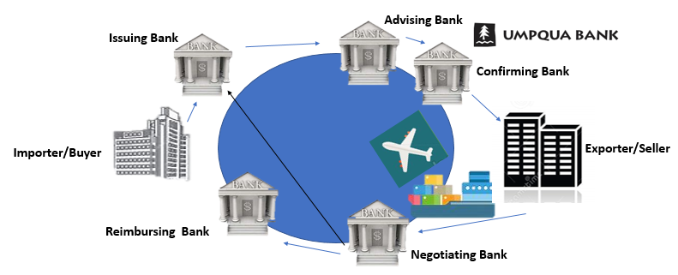
Visual Flow
7
2
3
4
1
8
5
6
7
Notes:
Steps : LC Instructions
LC Issued
Advised, Audit
Make Shipment
Submit Docs – sooner the better
Cover Letter
Draft
Invoice
Packing List
Proof of Shipment, BL, FCR???
Payment
This could all be done within 10 days turnover docs after release same day NEXT day, this is your DSO

Slide 8
8
How does this work?
Exporter negotiates
Exporter provides Letter of Credit Instructions
Foreign Buyer issues the LC through their [issuing] bank
LC is Advised/authenticated/sent via SWIFT to Umpqua Bank, or a U.S. bank
Beneficiary audits the LC to make sure they can comply, releases order/ships
Beneficiary presents documents to Umpqua Bank for payment (Cover Letter)
Bank examines documents
Beneficiary could receive payment in days, could be while still in transit
Buyer receives extended terms, as soon as Draft paid to the Seller in the U.S.
Draft paid at maturity at lower financing cost vs. in-country rates

Slide 9
The Sales
Negotiation…
Leverage the rate arbitrage…
9
Don’t pay for Bank fees, nor Logistics,
and ALWAYS be in-control!
Buyer: Asking for 60-day terms
Seller: Sales (after being coached on indicative rates) “Sure we could give you 90 or 120, maybe even 180, what rate are you paying?”
Buyer: We’re borrowing at 14%!
Seller: 14%??!!! If you issue an LC we will give you 180 days at XXXX%
Buyer: At 5% they are RUNNING to the bank to have access to THAT rate, and you are 100% secured!
DanielleAustin@UmpquaBank.com

Slide 10
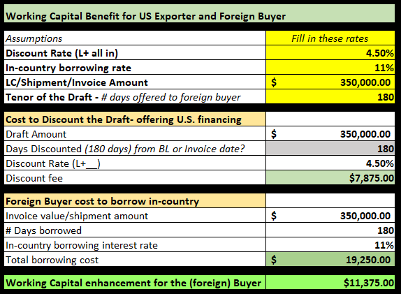
10
The Rate Arbitrage
Actual Savings to your Buyer!
Working Capital Benefit
for US Exporter
and the Foreign Buyer!
Win-Win-Win-Win-Win
Note email me for this spreadsheet; DanielleAustin@UmpquaBank.com
Notes:
XXXXXXXX

Slide 11
11
Negotiations…
Taking Control of the Freight,
Negotiation…
Buyer: What’s your FOB price?
Note right then, they are willing to pay for Freight
Seller: For our international shipments.. We contract carriage, but I’m sure I could get you a competitive price.
See what JUST happened?
You just brought ALL the control in-house, PLUS you can bill them back!
What are the required docs needed in an LC?
Invoice, Packing List, and PROOF of Shipment generated and signed by the 3rd party.
~~~
Make sure the Freight Forwarder works for YOU!
Don’t pay for Bank fees, nor Logistics,
and ALWAYS be in-control!
Notes:
If shipping EXW/FOB (Freight Collect… you are truly in a vulnerable position.. You are truly at the mercy of a 3rd party for that 1 essential document, right? I cant tell you how ma
Fun Fact: Do your buyers a favor, and break out the Freight, and Product. Don’t PAD the pricing – better for you on GL side and VAT for them. Another Win-Win!
ny times I received an AWB 7 times? Where it was incorrect… well, as you know its delaying my payment.
TOLERANCE +/- 2%????

Slide 12

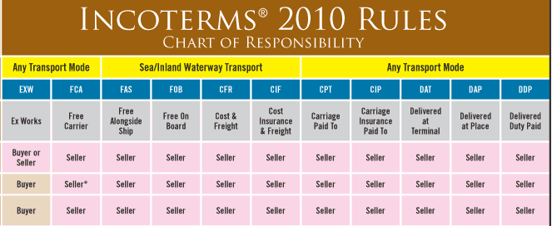
12
Importance of Incoterms
Notes:
Use the correct incoterm and avoid years of litigation
ie FCA vs EXW- who is loading the gearbox? The Truck shows up with a forklift? Prob not, it’s truly FCA___place of pick up/loading
You always want to be in control
Some prices changes while still on the water – export collection – couldn’t redirect once arrives in the other country product was refused, sat, damaged
Be in control
Plus this party generates the 3rd part doc on your behalf to present the bank for payment

Slide 13

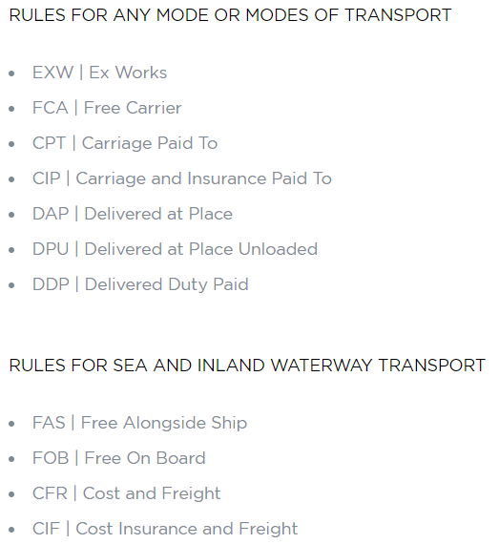
Incoterms 2020

Slide 14
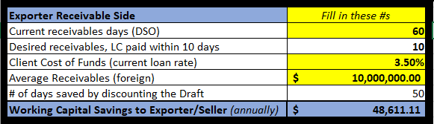
14
Working Capital enhancement
On the receivables side…
Notes:
Decrease your DSO – Days Sales outstanding
$10MM in A/R
Current A/R 60 days
Reduce to (within) 10
Bham! Almost a $48K in add’l w/c annually

Slide 15
15
Importance of LC Instructions
The LC needs to be sent via SWIFT and subject to the UCP (Uniform Customs and Practice for Documentary Credits), ICC (International Chamber of Commerce) latest version UCP600 or the eUCP 2.0.
The LC needs to be Advised, Drawn and Reimbursed through Umpqua Bank UMPQUS6P (or Citibank NY, or Standard Chartered Bank or ABC Bank NY).
        Umpqua Bank, Trade Operations
450 Sansome Street, San Francisco, CA 94111
SWIFT: UMPQUS6P
Important note: If the issuing bank is unable to advise directly to Umpqua Bank reference Umpqua Bank as 2nd Advising Bank and note in the additional conditions.
3. The LC must be freely negotiable and payable through a major U.S. Bank.
Notes:
Guess what? eUCP – established 2006 NO ONE is issuing per eUCP. Think about how much easier this process could be? Submit docs electronically we all have the technology, but the Issuing Bank need to issue per eUCP, just learned eUCP approved by the banking Committee
eUCP. The Uniform Customs and Practice for Documentary Credits (Supplement for Electronic Presentation) is a supplement to the International Chamber of Commerce´s Uniform Customs and Practice for Documentary Credits to accommodate presentation of documents and records alone or in combination with paper documents
eUCP and eURC Approved to go into effect Summer 2019 on DCW (Doc Credit World) News | Institute of International Banking Law & Practice The International Chamber of Commerce (ICC) has confirmed that revised eUCP and eURC are approved and will go into effect 1 July 2019.
*********Instructions vs. Guidelines / Requirements

Slide 16
16
Letter of Credit Instructions
The LC needs to be issued at the time of _____ the purchase order/sign contract/ 60 days prior to the ship date. ----------customize this to your business
Beneficiary is to be shown as: ---------- EXACTLY as it appears on Proforma, Invoice, P/L
ABC Exporter Inc
456 Main Street
Sacramento, CA 95814
Applicant/Buyer would need to reference
Company Name
Actual street address
Notes:
LC issued – 1 year in advance if customer product/machinery/equipment/project?
Or at the time of PO?
Beneficiary: Note: Make sure this is EXACTLY as it appears on your Invoice/Packing List (paste here)
Applicant: Note: Do not reference phone, fax and PO Box

Slide 17
17
LC Instructions – ask for the word doc
Description of goods/service as “generic product description” do not reference P.O. details.
Transferable LC is acceptable, nominate Umpqua Bank as transferring bank.
The LC needs to be in English and payable in USD, U.S. dollars.
Usance LCs are acceptable, the LC must reference “Acceptance commission and discount charges are for the account of the applicant, and drafts are negotiated at sight basis”. ----------note different language if LC 301
Notes:
General product description –
Walnuts, Almonds, Wine, Rice, Tomatoes
Inverter Drives, Servo and Motion Control, and Robotics Automation Systems
Specialized
Pumps, Valves, Fabrics / Fabric Technology – Fleece micro fleece, power grid, fire retardance, powershield,

Slide 18
18
LC Instructions
Drafts are payable at sight bases and discount and acceptance charges are for the account of the buyer. Deferred payment LCs are not acceptable.
Tolerance: The amount of the LC should reference +/- ____% or the exact amount.
Reference Incoterms 2010 - International Commercial [Shipping] Terms.
CIP/CIF ______ place (port) of destination
Transshipment: Allowed
Partial Shipments: Allowed
Notes:
Tolerance --- +/_ I like to use to cover freight cost…
If Freight Collect- remember it’s place of Pick up (vs destination)
Another reason why you want to contract carriage (Freight Prepaid)
We never want our goods to transship but difficult to avoid, as it opens us up to fraud/damage and that’s why you want that logistics provider working for YOU
#13 ONLY reference your INCOTERMS

Slide 19
19
LC Instructions
LC Bank fees: All charges are for the account of the applicant including reimbursement.
Expiration: LC is to expire in the U.S. and 21 days after the last ship date.
Period for Presentation: 21-30 days
Country of Origin: USA (Drop ship, or multiple shipping locations?)
Notes:
#16 I made a shipment Bahrain $400K and the LC was paid in 4 days and all charges paid by the buyer, because this is how our Instructions read
#19 USA Origina – no need to create a Certif of Origin – you are already letting them know
Remember your buyer is filling out an IMPORT LC Application
They are just checking off boxes, which will cause you more work.

Slide 20
20
LC Instructions
20. Documents Required
    Invoice in 3 copies
    Packing List in 3 copies
    Proof of shipment:
      Freight Cargo Receipt or
      Freight Forwarders Receipt or
      Forwarders Cargo Receipt or
      Express Bill of lading
Avoid requesting additional documents, we will provide outside of the LC. Note in the additional conditions one of the above freight documents in lieu of the Ocean B/L or Air Waybill.
Notes:
Sales DON’T be afraid to keep this at a minimum, let them know… “We love doing docs all day everyday” as the logistic/acct/credit/cust services-whoever prepares the docs is shaking their heads, but we can say this because you will provide all the other docs “inspection, phyto cert., analysis report, Certif Origin” OUTSIDE THE LC
Keep quantity- simple, don’t volunteer more docs
Remember that one area in the LC – maybe add’l conditions where the Issuing bank asks for add’l copies otherwise they will charge $10?? Well your customer/buyer doesn’t even know they inserted this into the LC, embarrassing when Bene asked it be removed.
Req. Docs – Help me – help You,,, this is where you now have LEVERAGE

Slide 21
21
LC Instructions
Consignment: The Freight document to reference:
  (Ocean shipments) Made out to the order of: The Issuing Bank and Notify the Applicant
  (Air shipments) Consigned To: The Issuing Bank and Notify the Applicant
Additional Conditions:
  Reference: Umpqua Bank as the 2nd Advising Bank
  Reference: LC payable XXX days after sight, Drafts will be paid at sight basis and discount and acceptance charges are for the account of the buyer.
  An FCR, or _____ is acceptable in lieu of the Ocean B/L or Air Waybill.
Please contact us should you have any questions prior to the LC being issued. Thank you,
ABC Exporter Inc
Contact:
Email: Contact@ExporterInc.com
Phone : 001-000-000-0000
Notes:
Note----------- Your LC Instructions are SO GOOD that you do not want a DRAFT before it’s open..
The reason? It causes delays, PLUS could be completely different from actual SWIFT message.. I.e. DRAFT will not ref reimbursing bank, Drawee, etc… That is what the issuing bank add to the Application that isn’t referenced. ------I know some people cringe at this.. But could cause add’l week delay
Receive the draft – audit it
LC Issued – audit it
Amend it
Whereas if they issued, could have received all amendments 1st time
TRUST THESE

Slide 22

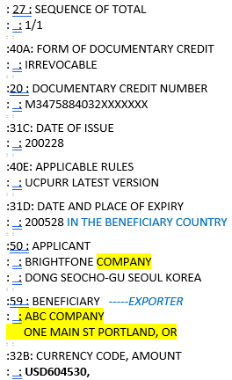
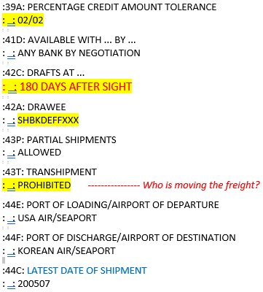
22
Sample LC #1
Notes:
Additional Conditions….. What else do we have to do in order to get paid?

Slide 23
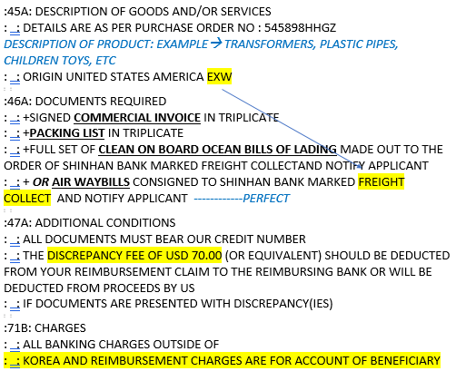
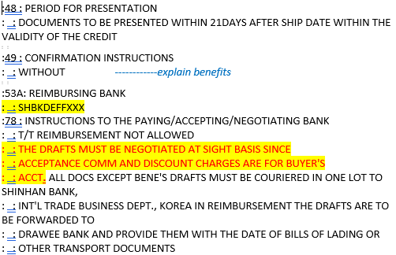
23
Sample LC #1
Notes:
The first thing I look at on any LC is 53A or 53D (as 20 year practitioner)
Show me the $$$
This is telling you who is paying YOU
If I don’t see it I start my Amendment List and start from the top
If you don’t see 53A or 53D – then it means its payable through the Issuing Bank
Who does the Issuing Bank work for?
If payable through your bank or major bank in the US, better control of the funds. When they examine docs and they are clean they look to see who is the “paying bank/Reimbursing “ if its them they “get” to pay you

Slide 24
24
Amendments LC #1
Bene Phone # - remove TEL: 530,999,0090
Transshipment – update to: Allowed
Last Ship Date – Extend to July 1, 2020
Expiry – Extend the Expiration date July 30, 2020
Documents – Remove 2 additional documents- provide outside the LC
  Bene Certificate
  Phyto Certificate
Period for Presentation – extend to 21-30 days
Reimbursing Bank: Add Umpqua Bank, or major US Bank
Notes:
Send via email
Remember you have all the leverage especially if a usance LC
Do not release the shipment until Amendment received
Always ask for Amendments
Sent via SWIFT – instantaneous
This is how you prevent discreps

Slide 25
Overtime
~Bonus Material~
25

Slide 26

26
Tricks of the Trade
PREVENT the Insurance Certificates for prepaid Freight Shipments (CIP/CIF incoterms). Contact your Insurance provider on their letter head prepare a letter stating, “The Beneficiary is insured world-to-world for the duration of the contract”. Present this letter with your LC Instructions, prior to LC being issued, the buyer presents to their Bank. It works!
Consolidate Documents! ISBP paragraph 8 Certifications and Declarations or the like may either be a separate document or contained within another document as required by the credit. i.e. Bene Cert., within the body of the invoice. We hereby certify…
NEVER, NEVER, NEVER send documents “on approval”
Notes:
Certifications and declarations
8) A certification, declaration or the like may either be a separate document or contained within another document as required by the credit. If the certification or declaration
appears in another document which is signed and dated, any certification or declaration appearing on that document does not require a separate signature or date if
the certification or declaration appears to have been given by the same entity that issued and signed the document.
NEVER Never never send Docs on Approval! Never! It’s a big red flag
After all your hard work from Sales winning the business after years of trying
Financing establishing the LC process and Instructions
100% secured to immediately UNSECURED
Its basically Open Acct! and It’s up to your buyer to approve (pay) the docs
UNLESS you have leverage an can hold that next shipment???
Correct docs IMMEDIATELY Express mail back to Exim/Nego Bank

Slide 27
27
Locate an LC anywhere in the world…
Ask your Buyer this…
Issuing Bank
Issue Date
$ Amount of the LC
LC #
Applicant Name
Advising Bank (If known)

Slide 28
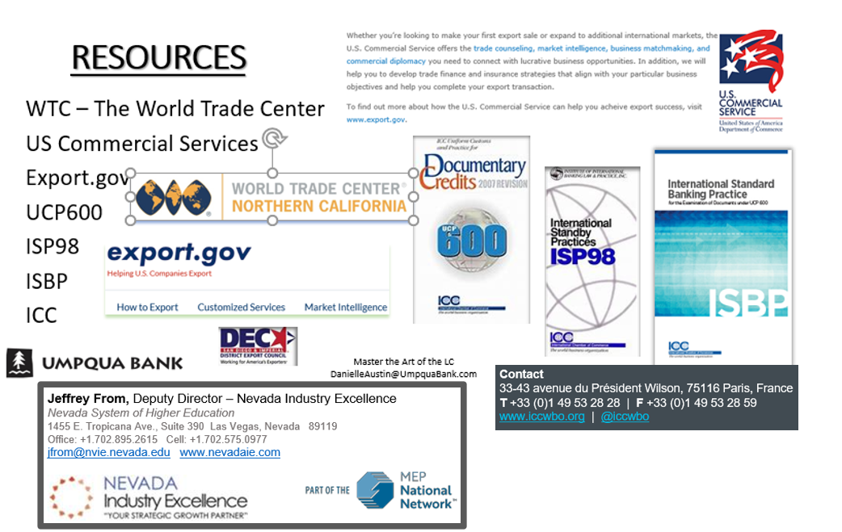

28
Essential Resources for Exporters

Slide 29

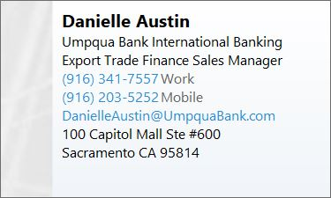
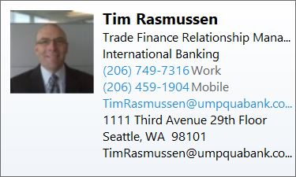
29
Stay connected…

Slide 30
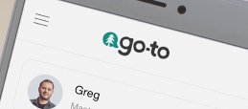
30
Umpqua Bank- a full-service bank!
The World Greatest Bank
Who we are - A bank run by people, not money. We are your bank people.
We’re committed to learning more about you than your account number. That’s why we take the time to understand how banking fits into your bigger picture, and give you the easy access and mobile tools you need to manage your money on your own terms. It’s why our stores feel more like a living
room than a bank branch. And why our associates will always remember your name.
We’ve grown beyond our roots as a small community bank, yet the spirit of community
will always be at the center of everything we do. Check out the Go-to App.->
Need to talk to your banker? Right now? Our small-town roots keep us grounded.
Like any great Oregonian origin story, ours starts with pioneers. The ones who founded Umpqua Bank were part of the tight-knit community in Canyonville, Oregon, a timber town nestled along the South Umpqua River
Through generations of hard work, that mighty little community came together to build what they needed: a school, a church, a grocery store, a diner, an auto shop. And when the citizens of Canyonville needed a better place than the local watering hole to cash their checks, they came together and built a bank. Since South Umpqua State Bank opened its doors back in 1953, we’ve grown a lot, but our values have stayed as strong as our roots. We believe in giving back. And we believe that when it comes to banking, people should always come first.

Slide 31
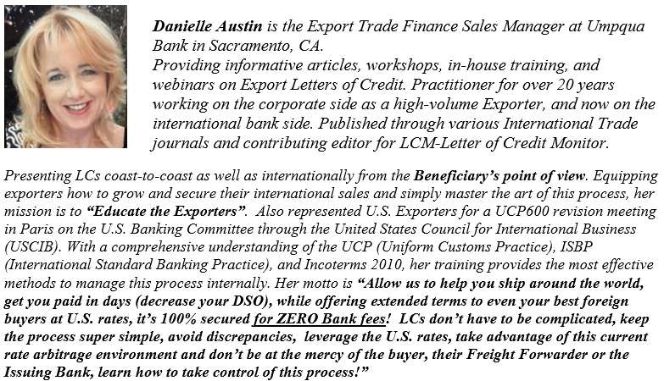
31
Speaker bio

Slide 32

Thank You

