Slide 1
Portland Economic Update Assn. of Financial Professionals
February 2019
Christian Kaylor
Christian.R.Kaylor@oregon.gov

Slide 2
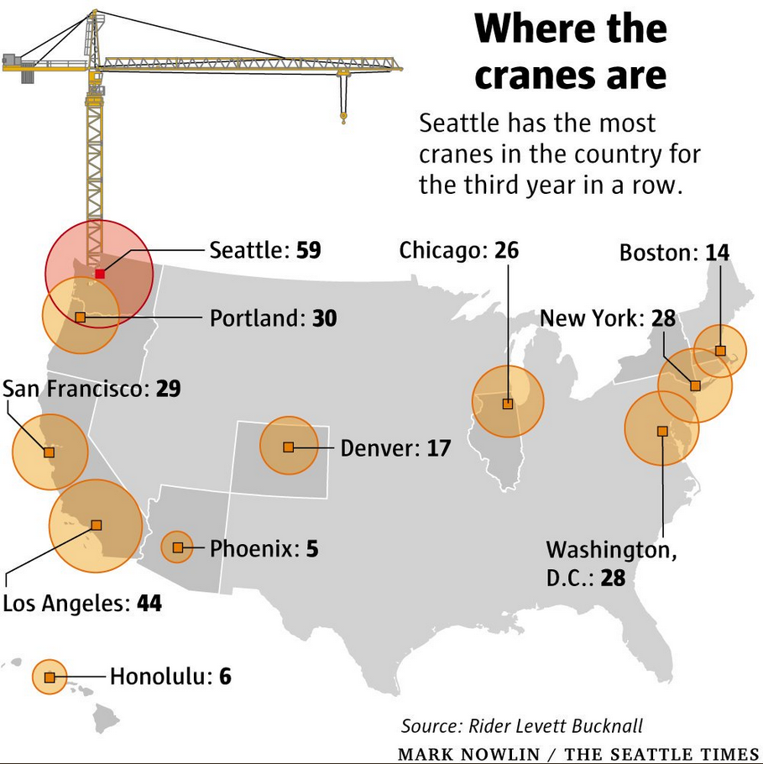
Cranes by US City
Seattle : 59
LA : 44
Portland : 30
San Fran : 29
DC : 28
NY : 28
Chicago : 26
Denver : 17

Slide 3
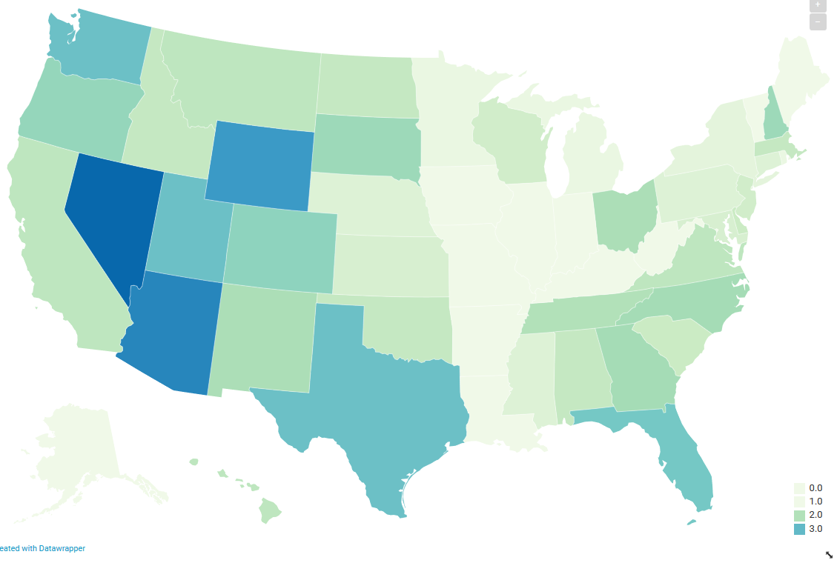
Job Growth by US State – 2018 (ish)
Nov 2017 to Nov 2018
#5
2.9%
#9
2.4%
1.1%
#10
2.3%
#3
3.4%
1.1%
1%
#1
3.9%
#6
2.9%
0.9%
1%
2.1%
1.8%
#8
2.5%
1%
0.9%
1.8%
#2
3.6%
1%
2%
2.2%
1.6%
#4
2.9%
2.2%
1%
#7
2.8%

Slide 4
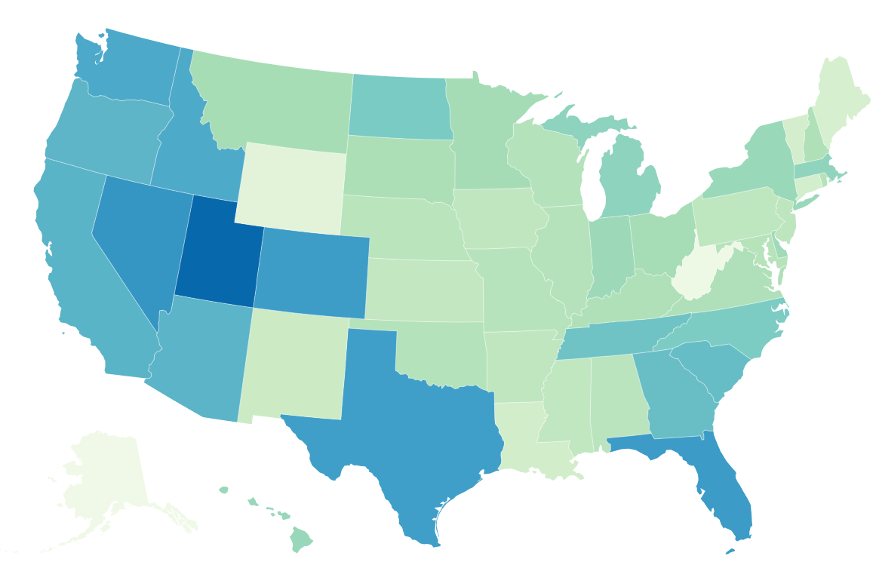
Job Growth by US State – 2011 to 2018
Oregon Job Growth was 19% from 2011 to 2018. The 10th Fastest in the US.
21%
#10
19%
21%
14%
14%
#2
23%
8%
#1
27%
12%
10%
20%
22%
18%
16%
19%
18%
18%
22%
#3
22%

Slide 5
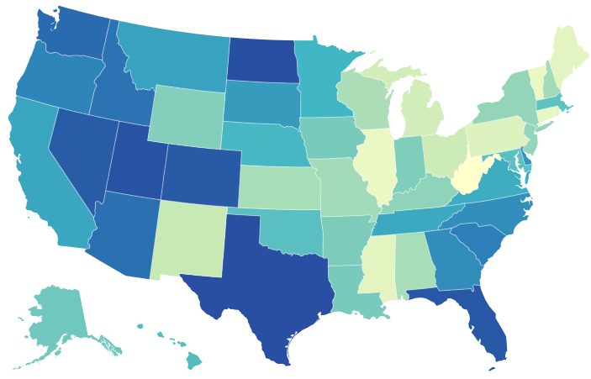
Population Growth by US State – 2010 to 2017
Oregon Growth was 8.0% from 2010 to 2017. The 11th Fastest in the US.
#7
9.9%
#11
8.0%
#9
9.3%
1.8%
#6
10.9%
0.7%
#3
11.8%
1.0%
#5
11.1%
#8
9.5%
#10
8.4%
#1
12.1%
#4
10.7%

Slide 6
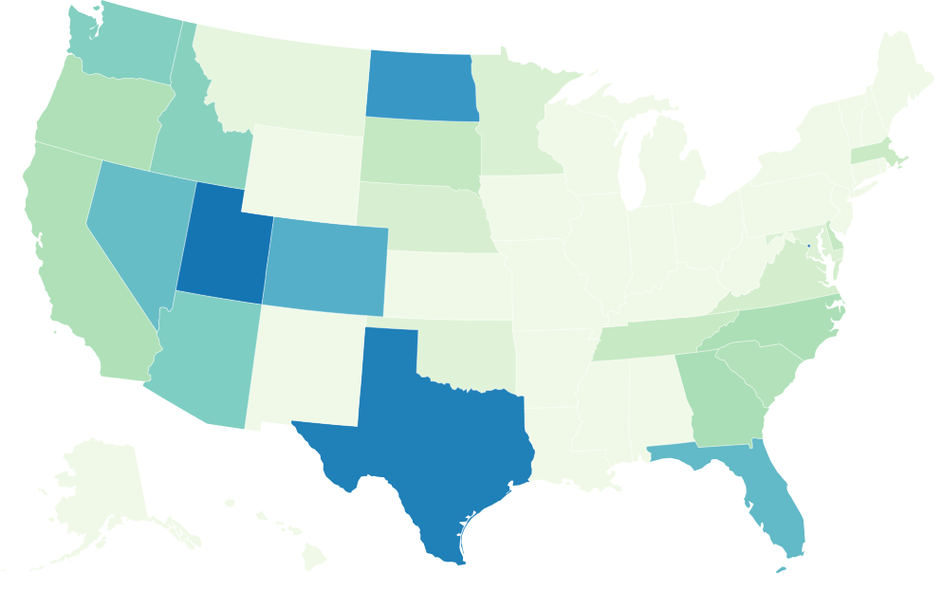
Population Growth by US State – 2010 to 2017
Age 18 to 65
#8
7%
#3
#12
5%
2.4%
#9
7%
1%
3%
-2%
-1%
-1%
#6
8%
#1
12%
-1%
#13
5%
#4
9%
-7%
0%
3%
-1%
#11
5%
#7
7%
4%
-2%
#14
5%
#10
5%
#2
11%
#5
9%

Slide 7
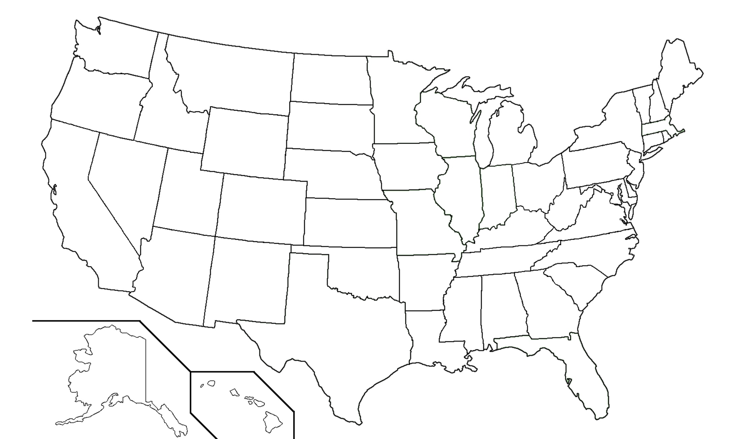
Top 12 US Metros for Job Growth – 2018 (ish)
Portland Job Growth was 2.4% in 2018. The 11th Fastest in the US.
Seattle
3.5%
Portland
2.4%
Cleveland
2.9%
San Jose
3.5%
Las Vegas
3.8%
Raleigh
2.8%
Oklahoma City
2.4%
Phoenix
4.2%
Dallas
2.6%
Austin
3.3%
Houston
3.7%
Orlando
4.8%
www.bls.gov/news.release/metro.t03.htm

Slide 8
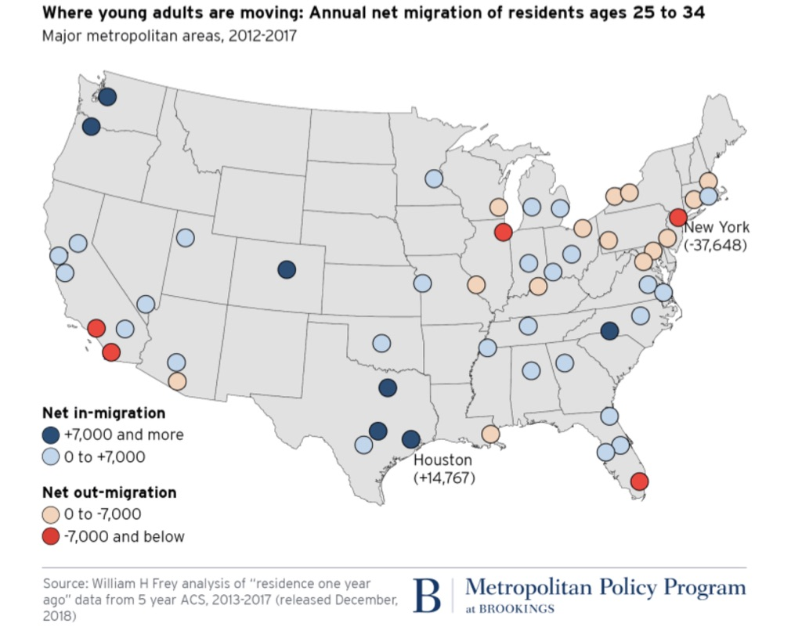

Slide 9
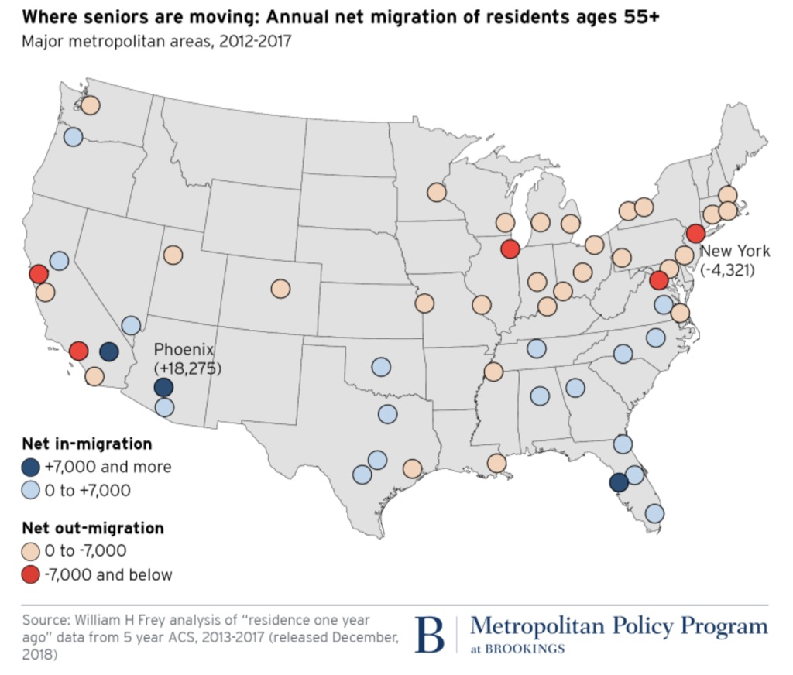

Slide 10
Millennials with College Degrees
Growth by US Metro
2010 to 2017
The population age 25 to 34 with a college degree grew by 30% from 2010 to 2017 in the Portland region.
Among the 50 largest US Metros, that’s the 8th fastest growth rate. Tied with San Jose and Miami.
50 Largest US Metros
US Census, ACS Table S0701

Slide 11
Employment Growth by US City
2013 to 2017
Portland enjoyed the fifth fastest job growth rate among the 50 largest US cities. That’s more than twice the growth rate of the United States.
The city of Portland added 67,341 jobs within the city limits from 2013 to 2017. That’s more than Minneapolis, Tampa and Salt Lake City combined.
50 Largest US Cities
US Census, ACS Table S0804

Slide 12
Washington DC | $ 95,013
San Jose | $ 94,362
San Francisco | $ 82,090
Boston | $ 76,462
Baltimore | $ 72,856
Hartford | $ 70,936
Seattle | $ 70,918
Minneapolis | $ 70,091
New York | $ 69,613
San Diego | $ 67,360
Denver | $ 66,021
Philadelphia | $ 65,305
Raleigh | $ 65,019
Virginia Beach | $ 64,428
Chicago | $ 64,191
Los Angeles | $ 63,727
Sacramento | $ 63,212
Austin | $ 62,662
Richmond | $ 62,191
Dallas | $ 61,207
Houston | $ 60,637
Kansas City | $ 60,611
Riverside | $ 60,194
Atlanta | $ 59,782
Portland | $ 59,666
Providence | $ 58,381
Cincinnati | $ 57,973
Las Vegas | $ 57,821
Columbus | $ 57,373
St. Louis | $ 57,231
Charlotte | $ 56,710
Phoenix | $ 56,638
Jacksonville | $ 56,570
San Antonio | $ 56,458
Rochester | $ 56,443
Milwaukee | $ 55,951
Indianapolis | $ 54,932
Detroit | $ 54,180
Nashville | $ 53,929
Pittsburgh | $ 52,496
Orlando | $ 52,246
Buffalo | $ 52,181
Oklahoma City | $ 51,977
Cleveland | $ 51,969
New Orleans | $ 51,860
Memphis | $ 51,009
Miami | $ 50,981
Louisville | $ 50,223
Birmingham | $ 49,704
Tampa | $ 48,952
2010
San Jose | $ 117,474
San Francisco | $ 101,714
Washington DC | $ 99,669
Boston | $ 85,691
Seattle | $ 82,133
Baltimore | $ 77,394
Minneapolis | $ 76,856
Denver | $ 76,643
San Diego | $ 76,207
New York | $ 75,368
Austin | $ 73,800
Raleigh | $ 72,576
Portland | $ 71,931
Hartford | $ 71,414
Los Angeles | $ 69,992
Philadelphia | $ 68,572
Chicago | $ 68,403
Sacramento | $ 67,902
Richmond | $ 67,633
Dallas | $ 67,382
Atlanta | $ 65,381
Providence | $ 65,226
Virginia Beach | $ 64,255
Nashville | $ 63,939
Houston | $ 63,802
Columbus | $ 63,764
Kansas City | $ 63,404
Riverside | $ 61,994
Cincinnati | $ 61,653
St. Louis | $ 61,571
Phoenix | $ 61,506
Charlotte | $ 61,156
Indianapolis | $ 59,566
Milwaukee | $ 59,448
Jacksonville | $ 58,709
Pittsburgh | $ 58,521
Detroit | $ 58,411
Louisville | $ 57,279
Las Vegas | $ 57,189
Rochester | $ 56,969
San Antonio | $ 56,774
Oklahoma City | $ 56,260
Buffalo | $ 55,448
Orlando | $ 55,089
Miami | $ 54,284
Birmingham | $ 53,107
Cleveland | $ 52,489
Tampa | $ 52,212
Memphis | $ 50,984
New Orleans | $ 50,528
2017
Median Household Income Growth by
Region 2010 to 2017
Portland enjoyed a 21% increase in household income in just 7 years.
That increase of $12,265 from 2010 to 2017 brought Portland from being the 25th wealthiest to the 13th among the 50 largest US metros.
50 Largest US Regions
US Census, ACS Table S1901

Slide 13
San Jose | $86.1
San Francisco | $78.5
Virginia Beach | $72.6
Washington DC | $71.0
Seattle | $68.6
San Diego | $68.3
Raleigh | $58.5
Long Beach | $57.6
Colorado Springs | $57.3
Oakland | $56.8
Charlotte | $56.4
Austin | $56.2
New York | $55.6
Boston | $55.2
Sacramento | $53.8
Fort Worth | $53.3
Denver | $53.2
Portland | $52.9
Las Vegas | $52.8
Minneapolis | $52.5
Los Angeles | $51.9
Omaha | $51.2
Jacksonville | $50.4
Mesa | $50.0
Wichita | $49.6
Phoenix | $49.4
Atlanta | $49.3
Kansas City | $49.2
Chicago | $49.0
Albuquerque | $49.0
Oklahoma City | $48.3
Houston | $48.2
Nashville | $47.9
San Antonio | $47.9
Louisville | $47.2
El Paso | $45.8
Dallas | $45.7
Fresno | $45.5
Columbus | $45.4
Tulsa | $45.1
Indianapolis | $43.8
Baltimore | $43.5
Tucson | $39.7
New Orleans | $39.4
Memphis | $39.3
Philadelphia | $38.5
Milwaukee | $37.3
Miami | $32.1
Cleveland | $28.5
Detroit | $28.3
2011
San Francisco | $ 110.8
San Jose | $ 104.7
Seattle | $ 86.8
Washington DC | $ 82.4
San Diego | $ 76.7
Virginia Beach | $ 72.6
Oakland | $ 70.6
Austin | $ 67.8
Boston | $ 66.8
Portland | $ 66.2
Denver | $ 65.2
Raleigh | $ 64.7
Charlotte | $ 61.4
New York | $ 60.9
Minneapolis | $ 60.8
Long Beach | $ 60.6
Fort Worth | $ 60.2
Los Angeles | $ 60.2
Colorado Springs | $ 59.5
Nashville | $ 57.7
Atlanta | $ 57.6
Sacramento | $ 56.9
Las Vegas | $ 56.7
Phoenix | $ 56.7
Omaha | $ 56.4
Chicago | $ 55.3
Mesa | $ 55.0
Oklahoma City | $ 52.1
Louisville | $ 52.0
Columbus | $ 51.7
Jacksonville | $ 51.5
Kansas City | $ 51.3
Houston | $ 50.9
Dallas | $ 50.6
Wichita | $ 50.5
Tampa | $ 50.5
Albuquerque | $ 50.5
San Antonio | $ 50.0
Fresno | $ 48.6
Indianapolis | $ 47.2
Baltimore | $ 47.1
Tulsa | $ 45.9
El Paso | $ 44.8
Tucson | $ 41.6
St. Louis | $ 41.4
Miami | $ 40.3
Philadelphia | $ 39.8
Memphis | $ 39.3
Milwaukee | $ 39.1
Cincinnati | $ 38.9
New Orleans | $ 37.0
Detroit | $ 30.3
Cleveland | $ 29.0
2017
Median Household Income Growth by
US City 2011 to 2017
Portland enjoyed the 4th fastest increase in household income among the 50 largest US cities. A 25% increase in just 6 years.
That increase of $13,290 from 2011 to 2017 brought Portland from being the 18th wealthiest city to the 10th among the 50 largest US cities.
50 Largest US Cities
US Census, ACS Table S1901

Slide 14
College Graduates
by US Metro
2017
The Portland Metro was the 10th best educated major metro in the U.S. in 2017, with 40% of adults having at least a four year college degree.
The Portland population with a college degree is more than Raleigh and Louisville combined.

Slide 15
Professional & Technical Services
Law Firms
Architectural Firms
Accounting Firms
Engineering Firms
Computer Systems Design
Consulting Firms
Scientific Research & Development Firms
Advertising Firms
Lawyers - $122,790
Software Developers - $103,020
Computer Analysts - $89,190
Civil Engineers - $84,400
Architects - $75,610
Accountants - $68,800
Medical Scientists - $76,490
42% Above Average
Employment Growth
2007 to 2017
Wages 2017
43% Above Average
46%
Higher

Slide 16
Computer, Engineering & Science Occupation Growth
2010 to 2017
The Portland Metro region added 30,751 jobs in Computer, Engineering & Science Occupations from 2010 to 2017.
That growth of 44% is twice as fast as all occupations combined.
US Census, ACS Table S2401

Slide 17
Households by Income Level Portland Region 2007 & 2017
45%
16%
3%
1%
-5%

Slide 18
Households by Income Level City of Portland 2007 & 2017
60%
23%
4%
-17%
-4%

Slide 19
Household Income 2005 to 2017
East Portland vs Rest of City of Portland
Gap of $35,000
= 58%
Gap of $18,000
= 30%
US Census, ACS Table S1901

Slide 20
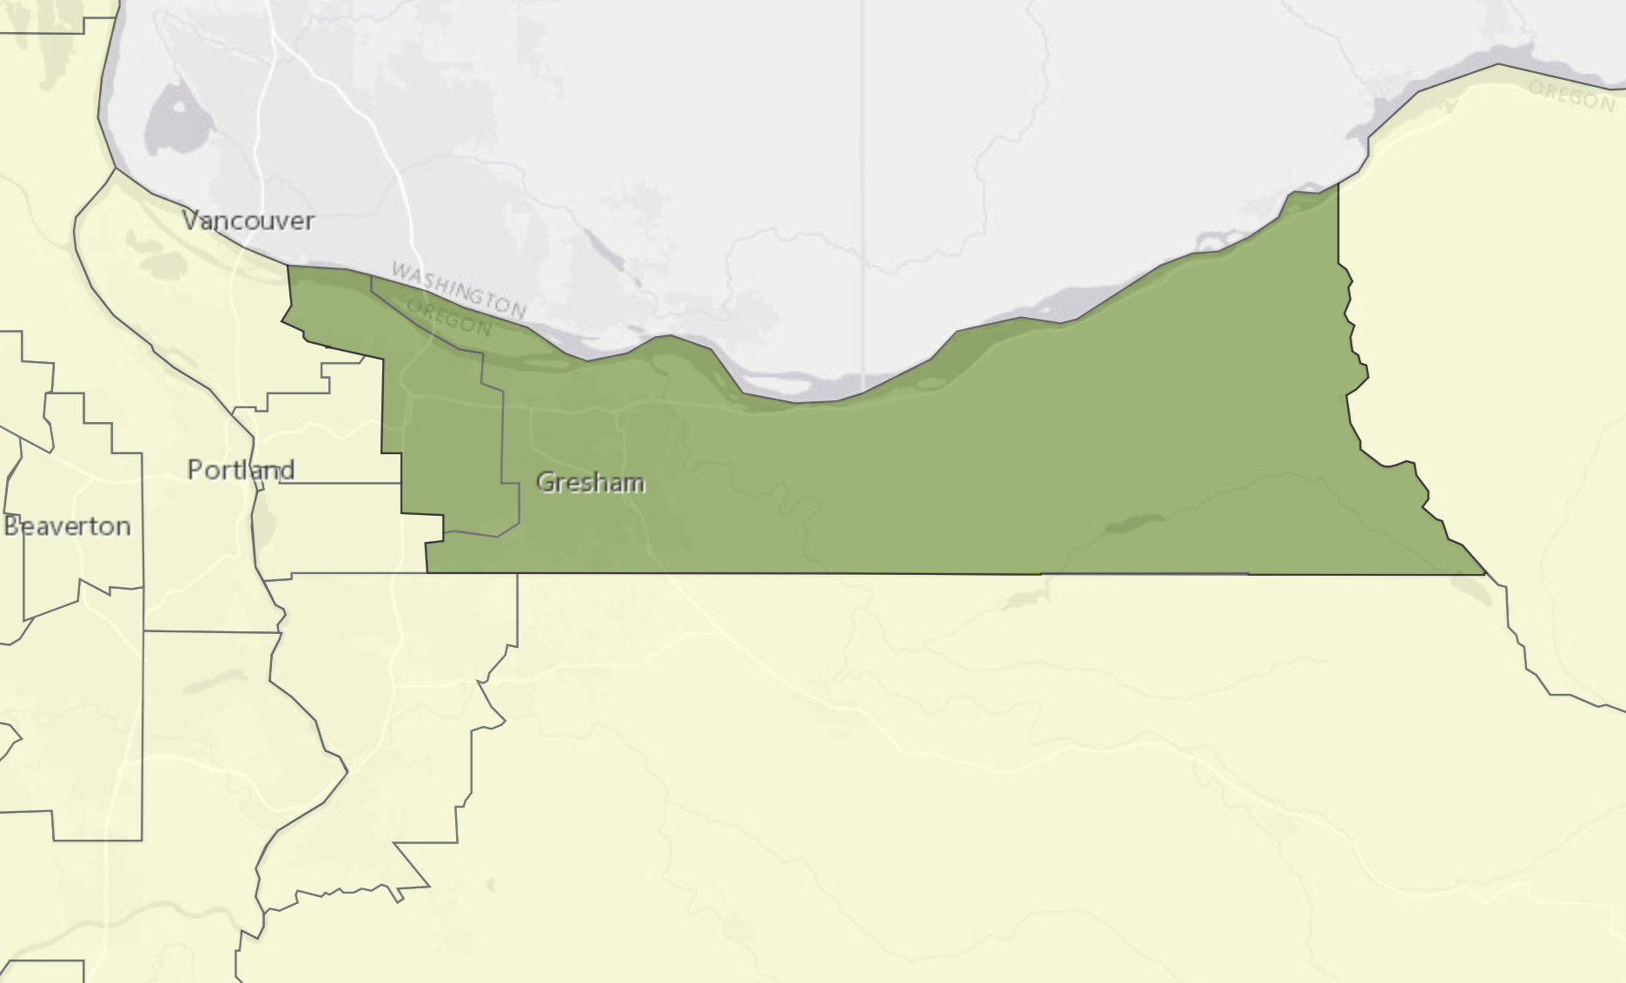
East Multnomah County
East County
Household Income
Mean: $69,338
Median: $60,000
West County
Household Income
Mean: $97,952
Median: $70,900

Slide 21
Households by Income Level 2017 East Multnomah County & West Multnomah County

Slide 22
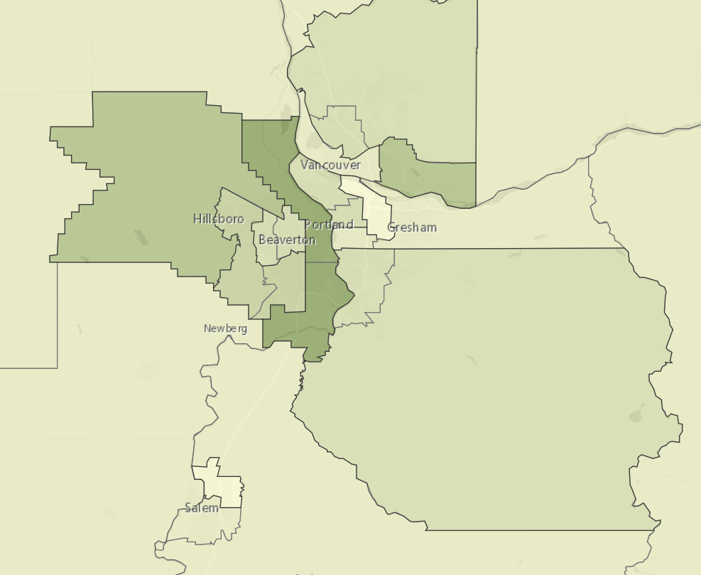
$54 K
$97 K
$81 K
$45 K
$72 K
$65 K
$98 K
$64 K
$42 K
$58 K

Slide 23
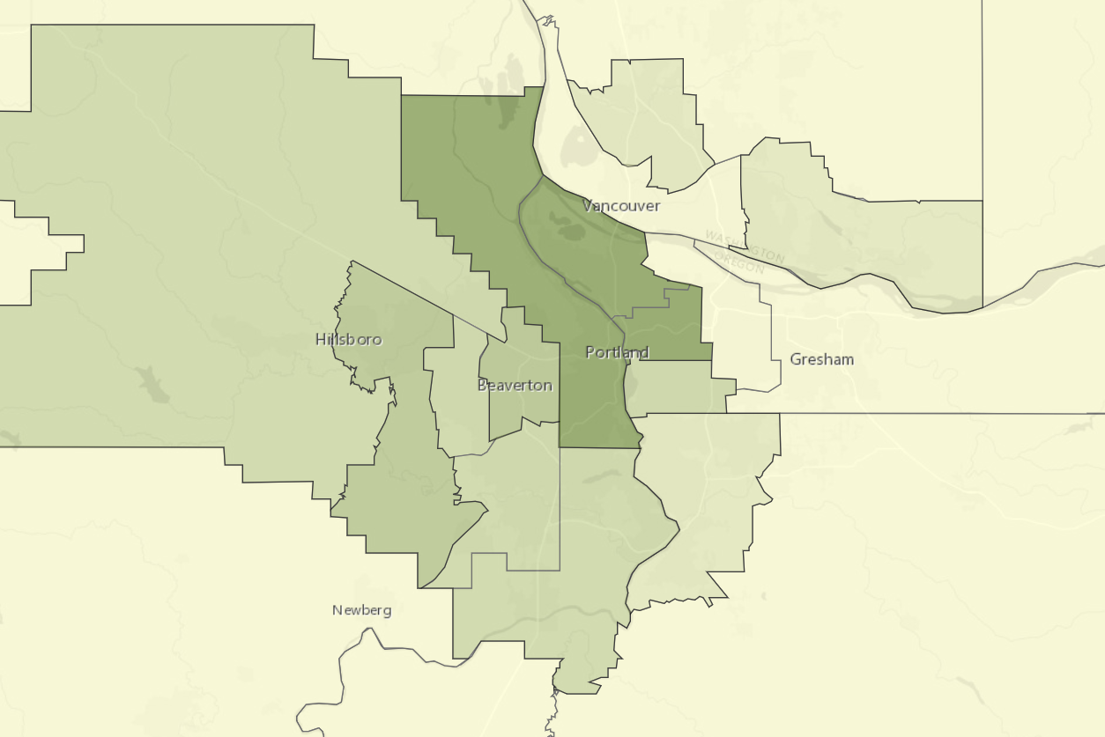
Millennials with College Degrees Age 25 – 34 2017 US Census
23%
62%
54%
71%
65%
26%
22%
46%
46%
40%
44%
26%
30%

Slide 24
Workers by Income Quintile
Portland Region - 2017
Among workers reporting wages in 2017, 20% earned less than $14,400.
At the other end of the range, 20% earned more than $78,000.
In the middle, 20% of workers earned between $30,000 and $48,000.
Multnomah, Washington, Clackamas and Clark Counties
2017 US Census, ACS PUMA

Slide 25
College Degree by Income Tier
Portland Region - 2017
Among workers earning less than $30,000 in 2017 only about one in four had a Bachelor’s degree.
Among workers earning more than $78,000 in 2017 about three out of four had a Bachelor’s degree.
Multnomah, Washington, Clackamas and Clark Counties
2017 US Census, ACS PUMA

Slide 26
People of Color by Income Tier
Portland Region - 2017
Among workers earning less than $30,000 in 2017 about one in three are people of color.
Among workers earning more than $48,000 only about one in five are people of color.
Multnomah, Washington, Clackamas and Clark Counties
2017 US Census, ACS PUMA

